Slide 1
Pre-Calc & Trig
Day 43

Slide 2

Bell Work
Prove:
$(cos{x }$tan⁡${x)}^{2}+(\sin{x}\cot{{x)}^{2}}=1$

Slide 3
From Last Time
Page 307 #37 – 46

Slide 4
5.1 Fundamental Trig Identities
Objective: Use fundamental trig identities to evaluate, simplify, and rewrite trig expressions

Slide 5
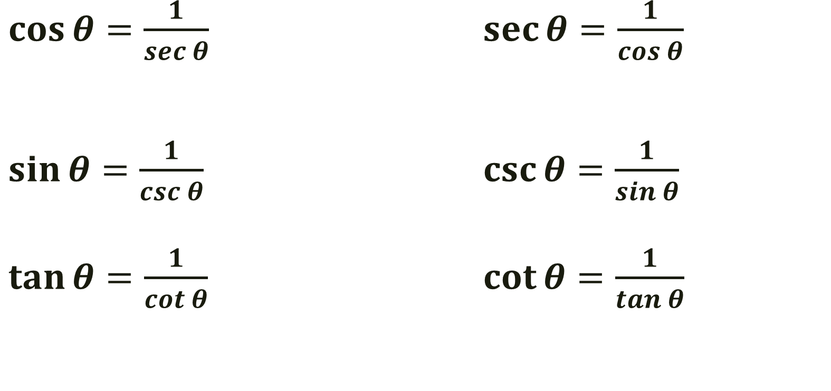
Reciprocal Identities
$\cos{θ=\frac{1}{sec θ}}$ $\sec{θ=\frac{1}{cos θ}}$
$\sin{θ=\frac{1}{csc θ}}$ $\csc{θ=\frac{1}{sin θ}}$
$\tan{θ=\frac{1}{cot θ}}$ $\cot{θ=\frac{1}{tan θ}}$

Slide 6

Quotient Identities
$\tan{θ=\frac{sin θ}{cos θ}}$ $\cot{θ=\frac{cos θ}{sin θ}}$

Slide 7
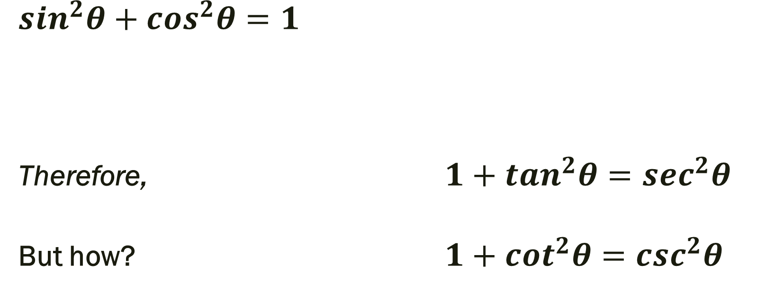
Pythagorean Identities
$\sin^{2}θ+cos^{2}θ=1$
Therefore, $1+tan^{2}θ=\sec^{2}θ$
But how? $1+cot^{2}θ=c{sc}^{2}θ$

Slide 8
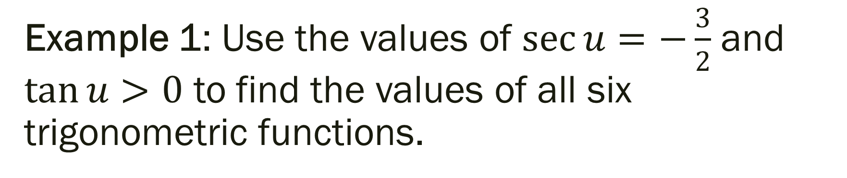
Example 1: Use the values of $\sec{u=−\frac{3}{2}}$ and $\tan{u>0}$ to find the values of all six trigonometric functions.

Slide 9
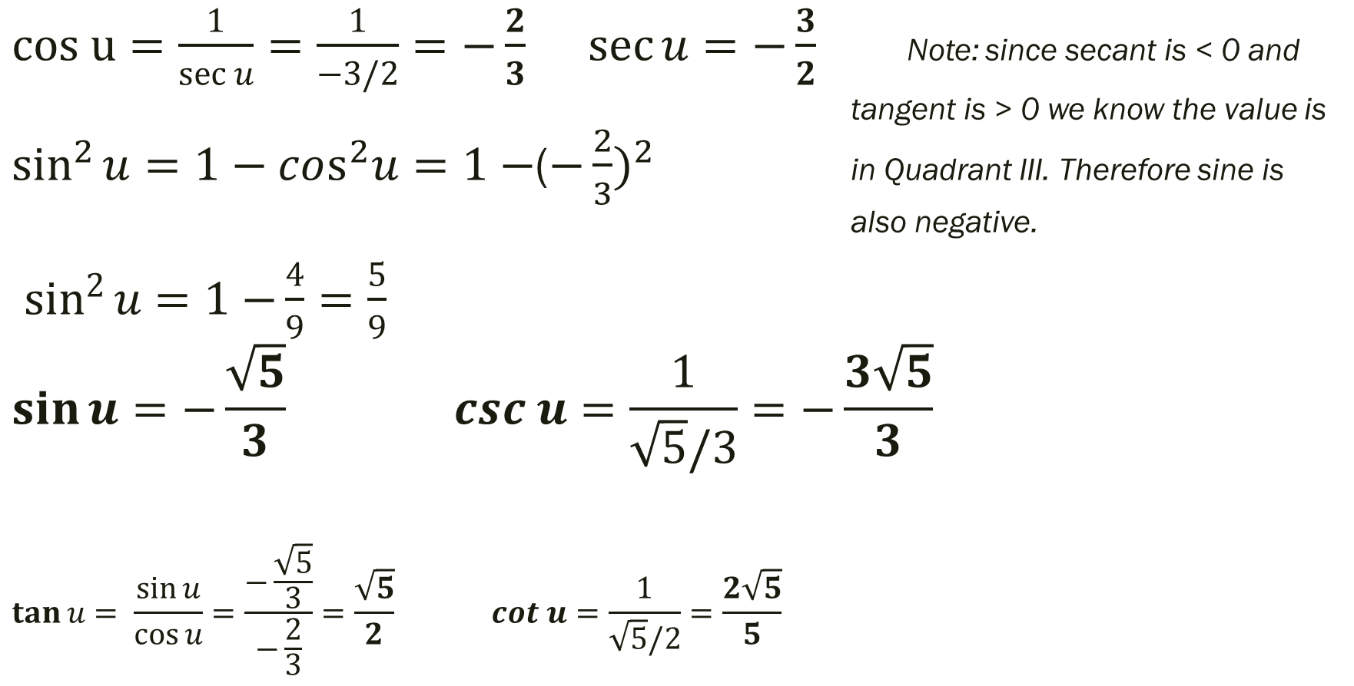

Example 1: Use the values of $\sec{u=−\frac{3}{2}}$ and $\tan{u>0}$ to find the values of all six trigonometric functions.
$cos u=\frac{1}{\sec{u}}{=\frac{1}{−3/2}=−\frac{2}{3}}$ $\sec{u=−\frac{3}{2}}$ Note: since secant is < 0 and tangent is > 0 we know the value is $sin^{2}{u=1−cos^{2}u=1−}$($−\frac{2}{3})^{2}$ in Quadrant III. Therefore sine is also negative.
$sin^{2}{u=1−}\frac{4}{9}=\frac{5}{9}$
$$\sin{u=−\frac{\sqrt{5}}{3}} csc u=\frac{1}{\sqrt{5}/3}=−\frac{3\sqrt{5}}{3}$$ $$\tan{u= \frac{\sin{u}}{\cos{u}}=\frac{−\frac{\sqrt{5}}{3}}{−\frac{2}{3}}}=\frac{\sqrt{5}}{2} cot u=\frac{1}{\sqrt{5}/2}=\frac{2\sqrt{5}}{5}$$

Slide 10

Solution
$cos u=−\frac{2}{3}$ $\sec{u=−\frac{3}{2}}$
$\sin{u=−\frac{\sqrt{5}}{3}} csc u=−\frac{3\sqrt{5}}{3}$
$$\tan{u}=\frac{\sqrt{5}}{2} \cot{u}=\frac{2\sqrt{5}}{5}$$

Slide 11
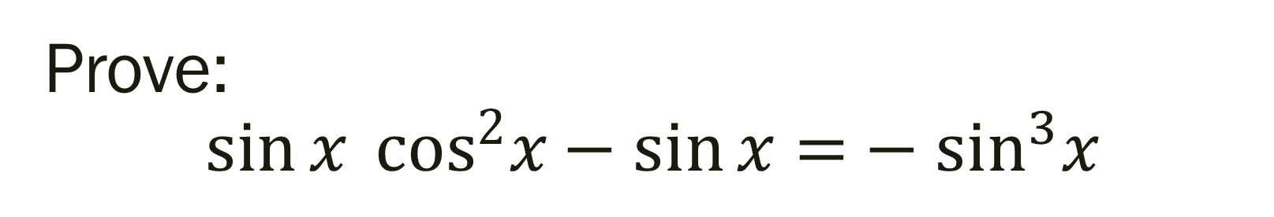
Prove: $$\sin{x} cos^{2}x−\sin{x=}−sin^{3}x$$

Slide 12
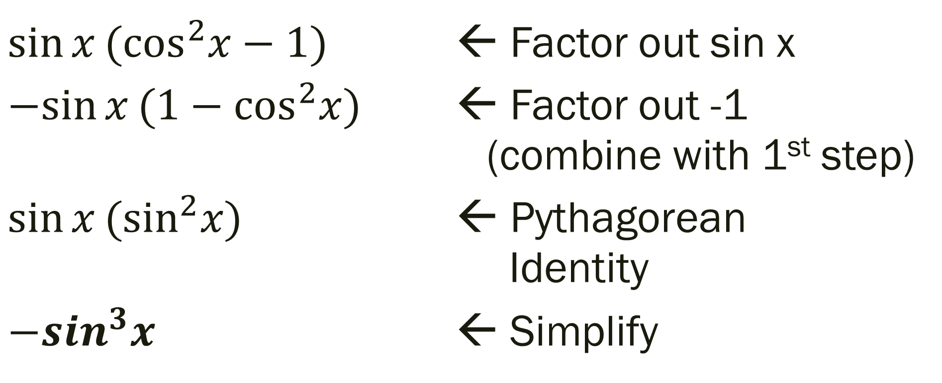
Prove: $$\sin{x} cos^{2}x−\sin{x=}−sin^{3}x$$
$\sin{x}(cos^{2}x−1)$ ← Factor out sin x
$−sin{x}(1−cos^{2}x)$ ← Factor out -1 (combine with 1st step)
$\sin{x}(\sin^{2}x)$ ← Pythagorean Identity
${−sin}^{3}x$ ← Simplify

Slide 13

Simplify: $\sin{w}+\cot{w}\cos{w}=\csc{w}$

Slide 14
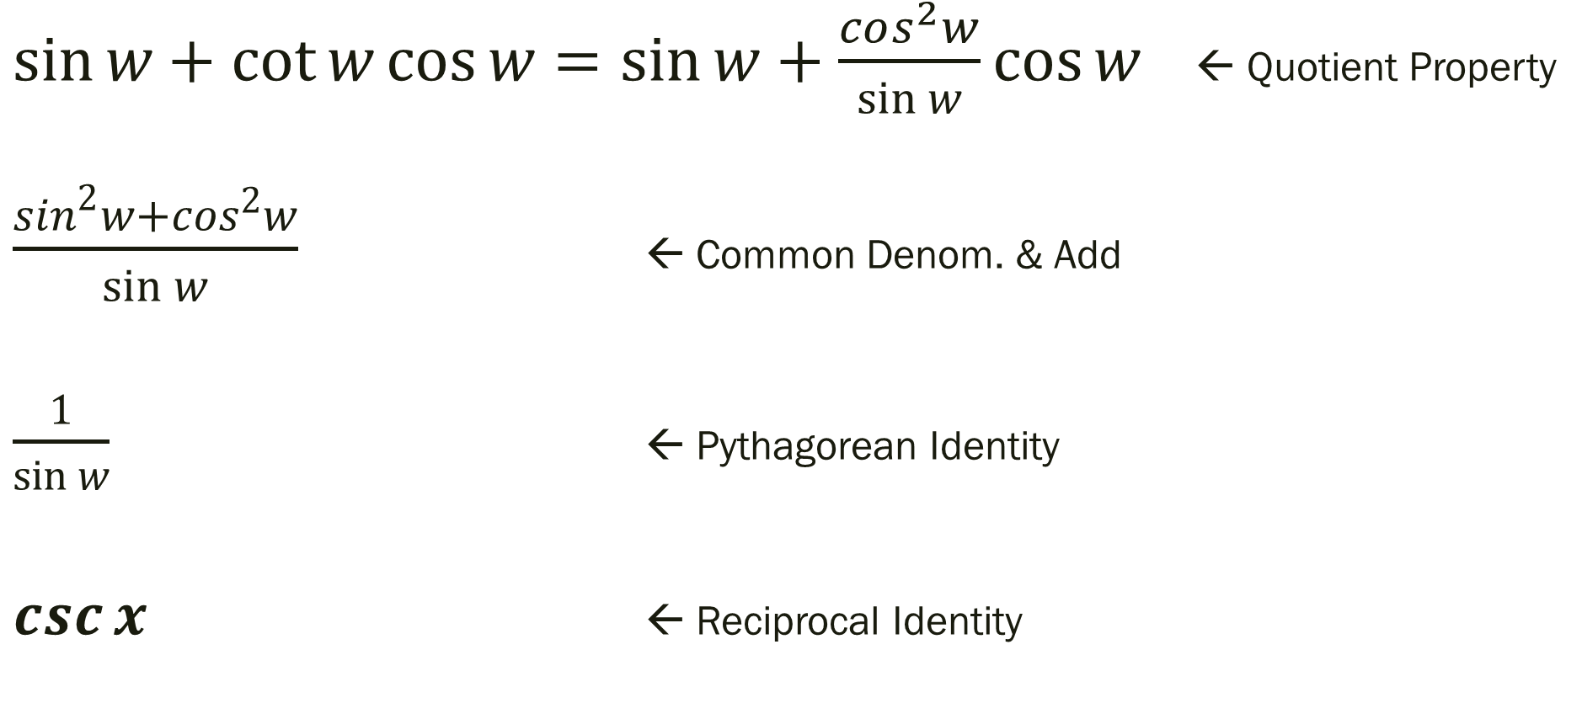
Simplify: $\sin{w}+\cot{w}\cos{w}=\csc{w}$
$\sin{w}+\cot{w}\cos{w}=\sin{w}+\frac{cos^{2}w}{\sin{w}}\cos{w}$ ← Quotient Property
$\frac{\sin^{2}w+cos^{2}w}{\sin{w}}$ ← Common Denom. & Add
$\frac{1}{\sin{w}}$ ← Pythagorean Identity
$\csc{x}$ ← Reciprocal Identity

Slide 15

Perform the addition and simplify: $$\frac{\sin{t}}{1+\cos{t}}+\frac{\cos{t}}{\sin{t}}$$

Slide 16
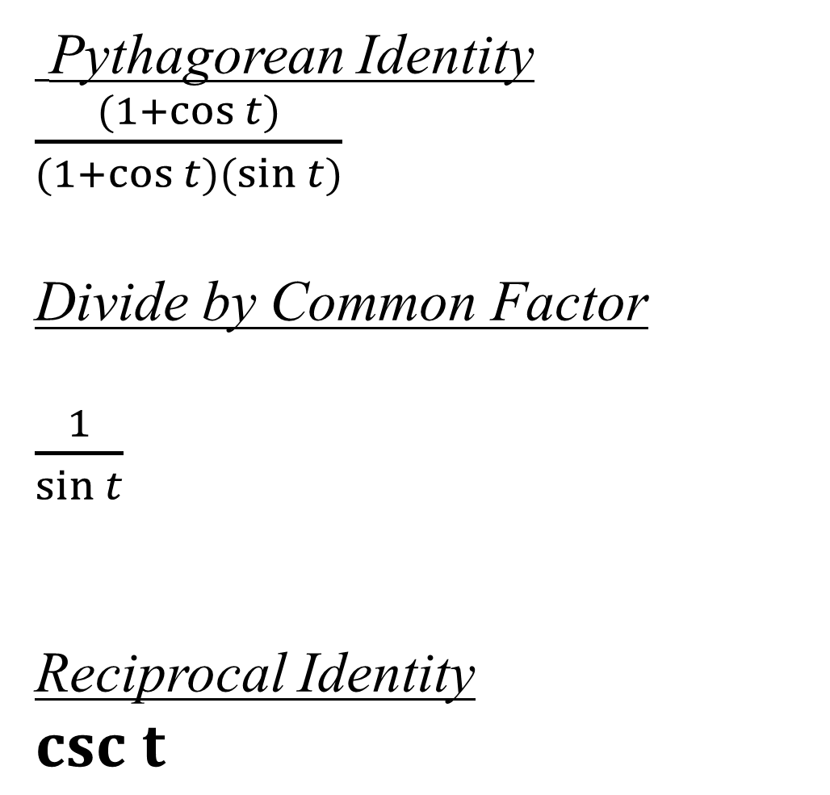
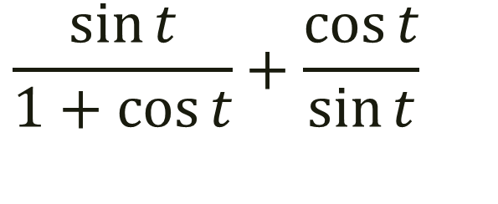
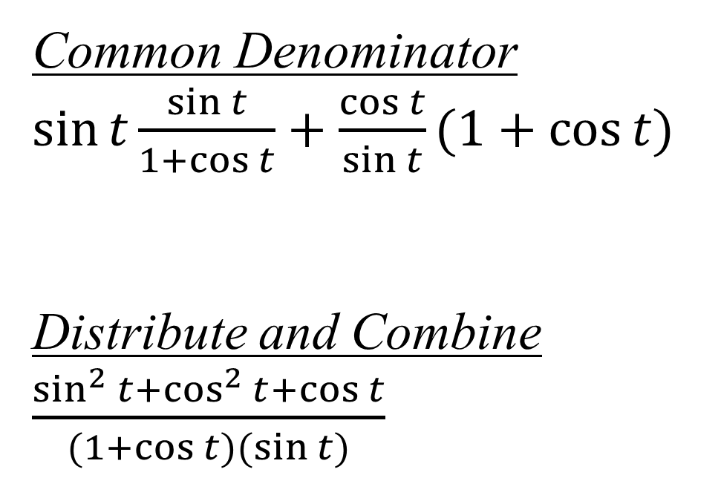
$$\frac{\sin{t}}{1+\cos{t}}+\frac{\cos{t}}{\sin{t}}$$
Pythagorean Identity
$\frac{(1+\cos{t})}{(1+\cos{t)(\sin{t)}}}$
Divide by Common Factor
$\frac{1}{\sin{t}}$
Reciprocal Identity
$csc t$
Common Denominator
$\sin{t}\frac{\sin{t}}{1+\cos{t}}+\frac{\cos{t}}{\sin{t}}(1+\cos{t)}$
Distribute and Combine
$\frac{sin^{2}{t}+cos^{2}{t}+\cos{t}}{(1+\cos{t)(\sin{t)}}}$

Slide 17
For Next Time
Day 1: Pg 377 #5, 6, 13, 14, 25–31 (odd), 79, 123
Day 2: Pg 377 #41–49 (odd), 125

